Slide 1
Music Recommendation System
Knowledge Representation and the Semantic Web
Project Idea Seminar
Eduardo Pereira
Juan Carlos Aguilar
Utku Atay
Yi Yang
Tingjun Yuan

Slide 2
Use Case and Functionalities
Main functionality:
Profile based music recommendations
Next Steps:
Update model with user ratings
On queue, slightly less profile based recommendation

Slide 3
To Do’s
Design a shared ontology with data from MusicBrainz and YAGO.
Design SPARQL queries to extract data from the knowledge graphs.
Define custom rules for deriving recommendation using rule-based reasoning.
Define user questions for user profile building.

Slide 4
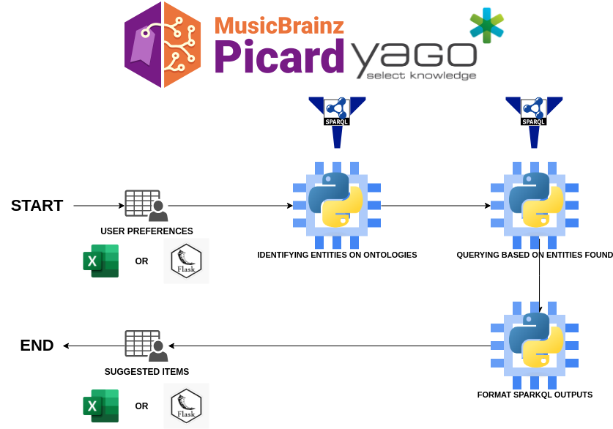
Matching Engine

